Slide 1
Regional Strategic Planning Forum
Driving Digital Innovation
Strategic Planning Forum
Penn State Behrend
Thursday, March 30, 2017
1:00 PM – 2:30 PM

Slide 2
Today’s Panelists
David Hunter, Professor and Department Head of Statistics
Jenni Evans, Professor of Meteorology and Director of Institute for CyberScience
Linda LaSalle, Director of Health Promotion and Wellness, University Health Services
Mary Beth Rosson, Professor and Associate Dean, College of IST
John Yen, Professor of IST, Co-Chair of DDI Steering Committee
Driving Digital Innovation

Slide 3
DDI Steering Committee
John Yen, Professor of IST, Co-Chair
Douglas Miller, Professor of Geography, Co-Chair
Guido Cervone, Associate Director of the Institute of CyberScience
James Delattre, Assistant Vice President for Research & Industrial Partnerships
José Duarte, Professor of Architecture and Landscape Architecture, Stuckeman Chair of Design Innovation
Karen Estlund, Associate Dean for Technology and Digital Strategy (Libraries)
Maggie Gordon-Froehlich, Associate Professor of English and Women’s Studies
David Hunter, Professor and Department Head of Statistics
Eun Kyoung, Assistant Professor of IST
Matthew Ferrari, Associate Professor of Biology
Vasant Honavar, Professor and Edward Frymoyer Chair of IST
Richard Lomotey, Assistant Professor of IST
Sascha Meinrath, Palmer Chair in Telecommunications
Nick Mohammed, Associate Professor of Communication Arts and Humanities
David Norloff, Senior Lecture in Telecommunications
Denise Ogden, Professor of Marketing
Stuart Selber, Professor of English
Susan Sinnott, Professor of Materials Science and Engineering
Jenn Steward, IT and Compliance Trainer
Laurel Terry, Professor of Law
Alfonso Mejia, Assistant Professor of Civil and Environmental Engineering
David Hughes, Assistant Professor of Entomology and Biology
with contributions from
Driving digital innovation

Slide 4
Questions, comments, ideas?
Twitter: #PSUplan
Email: strategicplan@psu.edu - subject line
“Driving Digital Innovation”
Forum details:
http://news.psu.edu/story/458124/2017/03/24/%E2%80%98driving-digital-innovation-topic-upcoming-strategic-planning-forum
Driving digital innovation

Slide 5
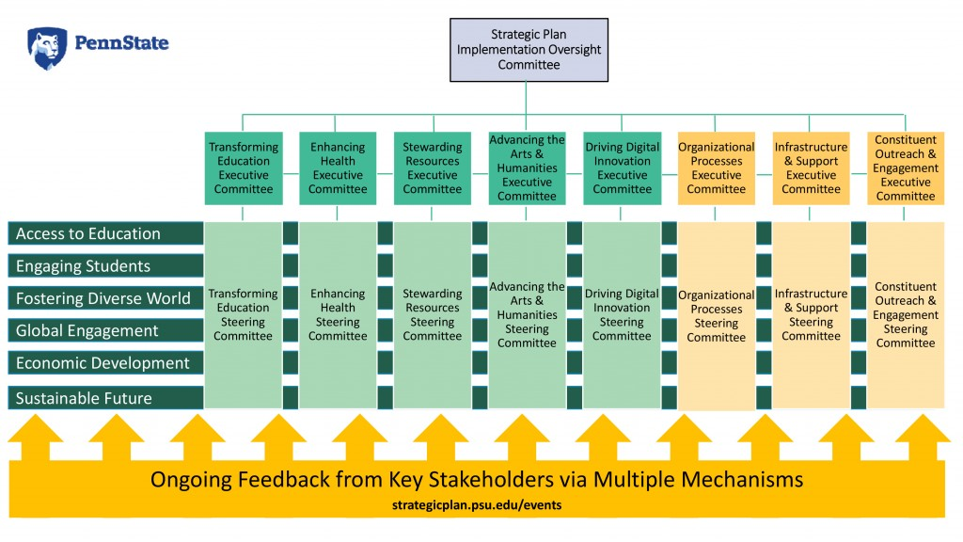
Driving digital innovation

Slide 6
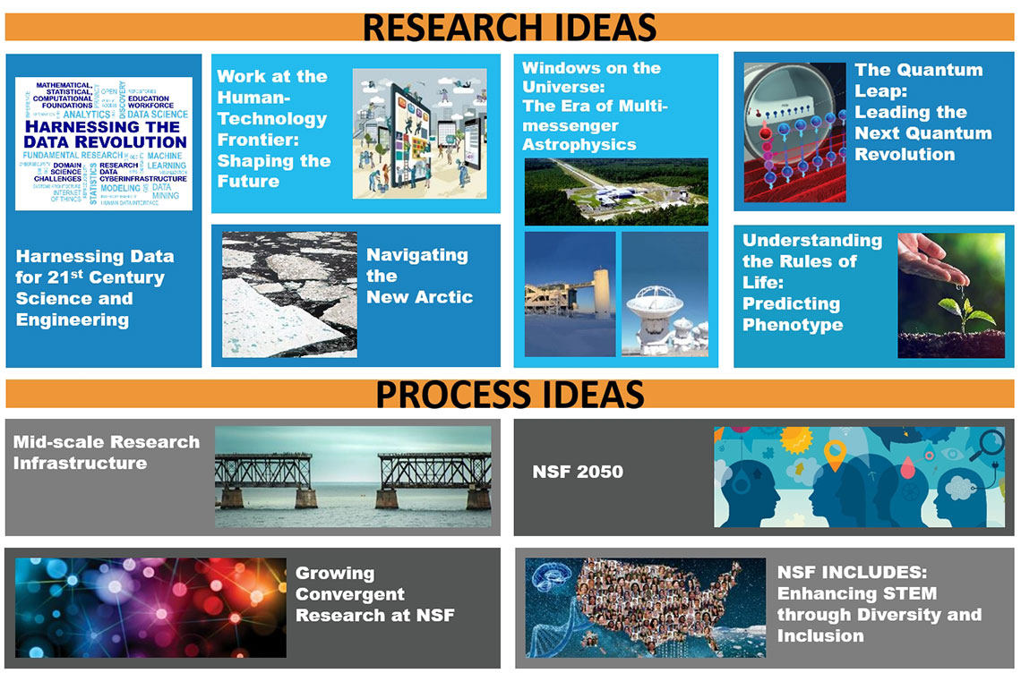
10 Big Ideas for Future NSF Investments
Driving digital innovation

Slide 7

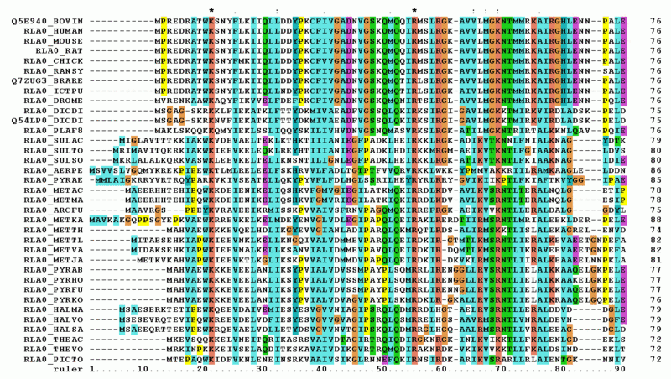
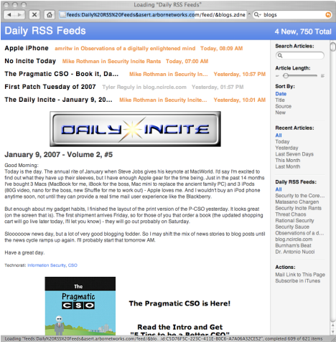

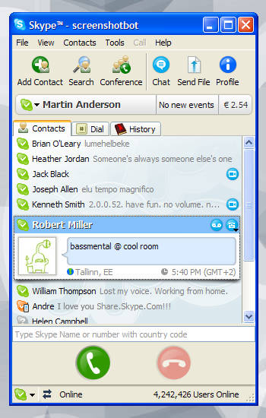
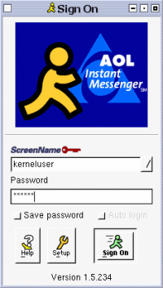
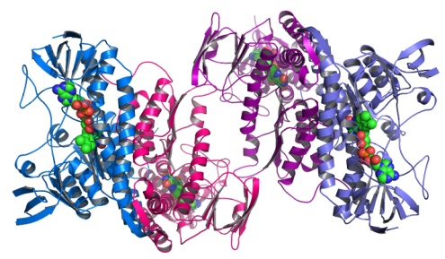
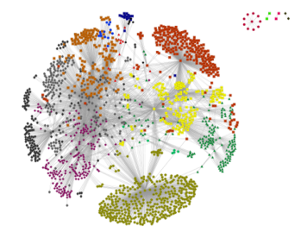
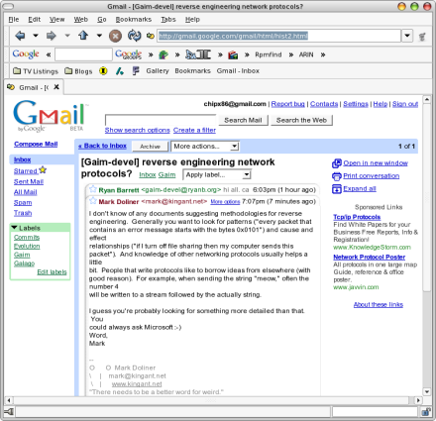
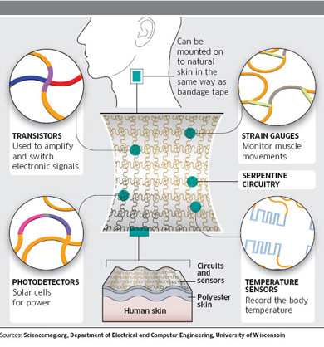

Data to be Harnessed
Omics
Digital Media
VIDEO
MOBILE
VOIP
BLOGS
EMAIL
IM
Human Sensors
Health Care
Sense
Assess
Intervene
Evaluate
Identify
Public
Social
Personal
Source: Keith Marzullo
Notes:
7

Slide 8
How to harness data? Data Sciences
Experiment Design
Hypothesis Testing
Statistical Models
Statistical Inference
Data Models
Machine Learning
Text and Multimedia Processing
Cluster Computing
Scalable Programming
Visualization
Big Data Tools
Computer Science Informatics (IST)
Mathematics Statistics
DATA
SCIENCES
Data Intensive Disciplines
Penn State is a leader in Data Sciences Education.

Slide 9
Questions for the Forum
Strategic Initiatives Recommended by the DDI Committees
Strategic Joint Initiatives with other Strategic Planning Committees
Questions from you (participants of the forum)
Driving digital innovation

Slide 10
#1 Build capacity for health informatics research and expand capacity for research using biomedical and health sciences big data.
How can we leverage health-related information to advance digital innovation toward precision health and discovery informatics while protecting sensitive information?
Driving digital innovation

Slide 11
#2 Build, coordinate, and strengthen our capabilities in data sciences and analytics as well as AI.
How can we build on Penn State’s inter-college education and research programs related to Data Sciences, Human Technologies, and Artificial Intelligence (AI) to position Penn State further as a global leader in driving digital innovation?
Driving digital innovation

Slide 12
#3 Coordinate and strengthen programs related to developing secured, accessible, and interoperable cyber infrastructure.
How can we enhance the existing cyber infrastructures to enable driving digital innovation research, education, and outreach across geographically distributed campuses of Penn State?
Driving digital innovation

Slide 13
#4 Leverage human technology to inform and be informed by digital innovation initiatives/.
How can we leverage existing human technology research, education, and outreach to inform and be informed by digital innovation initiatives?
Driving digital innovation

Slide 14
#5 Can we address student health or wellbeing through digital innovation initiatives?
How can we leverage technology and infrastructures related to wearable devices to develop digital innovation initiatives that are related to student health and learning?
Driving digital innovation

Slide 15
Your questions and ideas?
Driving digital innovation

Slide 16
Questions, comments, ideas?
Twitter: #PSUplan
Email: strategicplan@psu.edu - subject line
“Driving Digital Innovation”
Forum details:
http://news.psu.edu/story/458124/2017/03/24/%E2%80%98driving-digital-innovation-topic-upcoming-strategic-planning-forum
Driving digital innovation

Slide 17
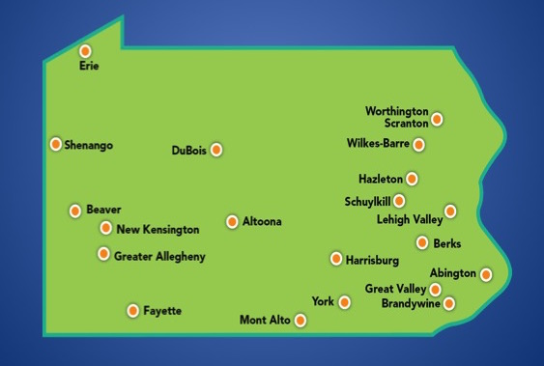
Community Forums
TODAY
Driving Digital Innovation
March 30
Transforming Education
March 22
NEXT
Enhancing Health
April 7
Stewarding our Planet’s Resources
January 23
Advancing the Arts and Humanities
February 23
strategicplan.psu.edu/events
Driving digital innovation

Slide 18
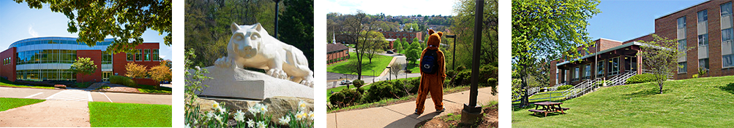
Thank You!
strategicplan.psu.edu
Driving digital innovation

